Slide 1
A Comparison Between Cyclosporine and Tacrolimus-Based
Immunosuppression for Renal Allografts
Dr.seyed sadraddin rasi hashemi

Slide 2
Transplantation Proceedings, 35, 2391–2394 (2003)

Slide 3
The introduction of the calcineurin inhibitor (CNI) cyclosporine (CsA), revolutionized solid organ transplantation during the 1980s.
Cyclosporine use was associated with a substantial reduction in the occurrence of rejection and the prolongation of allograft survival.
Transplantation Proceedings, 35, 2391–2394 (2003)

Slide 4
These benefits came with a price, paid via an increase in the
incidence and severity of hypertension and a number of
drug-related adverse events, most notably nephrotoxicity,
neurotoxicity, hyperlipidemia and hirsutism.
Transplantation Proceedings, 35, 2391–2394 (2003)

Slide 5
The last decade has seen the introduction of another CNI, tacrolimus (Tac), use of which has been increasing, at least in part, because of its reputed better adverse event profile.
Most studies have indicated that the use of Tac is associated with a reduction in the frequency and severity of acute rejection episodes, less hypertension and hyperlipidemia and the potential for improved long-term graft function.
Transplantation Proceedings, 35, 2391–2394 (2003)

Slide 6
The present study examined the outcome of renal allograft recipients who received either CsA- or Tac-based immunosuppressive therapies between January 1995 and December 2000.
Transplantation Proceedings, 35, 2391–2394 (2003)

Slide 7
RESULTS
At the most recent follow up (Table 5), there was a significant decrease in SBP favouring tacrolimus (127.5 15.8 vs 135.8 19.5 mm Hg; P .0077).
The percentage of patients developing new onset diabetes mellitus (defined as the requirement for continued therapy with insulin or oral hypoglycemic agents) was similar in the two groups at 9.3% for tacrolimus and 8.1% for cyclosporine
.
Transplantation Proceedings, 35, 2391–2394 (2003)

Slide 8
RESULTS
The present retrospective chart review suggests that, for patients who receive exclusive therapy with CsA or tacrolimus based regimens, the expected benefits are approximately equal, with perhaps a suggestion that SBP especially may be easier to control in patients receiving tacrolimus.
Transplantation Proceedings, 35, 2391–2394 (2003)

Slide 9
Transplantation Proceedings, 35, 2391–2394 (2003)

Slide 10
Transplantation ■ August 2016 ■ Volume 100 ■ Number 8

Slide 11
Although the calcineurin inhibitors (CNIs), which include tacrolimus (TAC), now form the backbone of current immunosuppression, their long-term nephrotoxicity has long been a clinical concern.
Transplantation ■ August 2016 ■ Volume 100 ■ Number 8

Slide 12
Our initial study identified frequently occurring and progressive CSA nephrotoxicity10 years after kidney transplantation and questioned the suitability of CNI as maintenance agents.
Since then, transplant practice has evolved: transitioning from high-dose CSA therapy to lower-dose TAC, and supplemented by use of mycophenolate, robust induction regimes, antiviral prophylaxis, and better technologies to detect donor-specific antibodies (DSA).
Transplantation ■ August 2016 ■ Volume 100 ■ Number 8

Slide 13
These have reduced acute rejection rates and early immune-mediated allograft injury.
Transplantation ■ August 2016 ■ Volume 100 ■ Number 8

Slide 14
Transplantation ■ August 2016 ■ Volume 100 ■ Number 8

Slide 15
We evaluated a well-characterized cohort of combined renalpancreas transplant recipients for evidence of nephrotoxicity using a programme of regular, prospective surveillance kidney biopsies taken up to 10 years after transplantation and beyond.
Transplantation ■ August 2016 ■ Volume 100 ■ Number 8

Slide 16
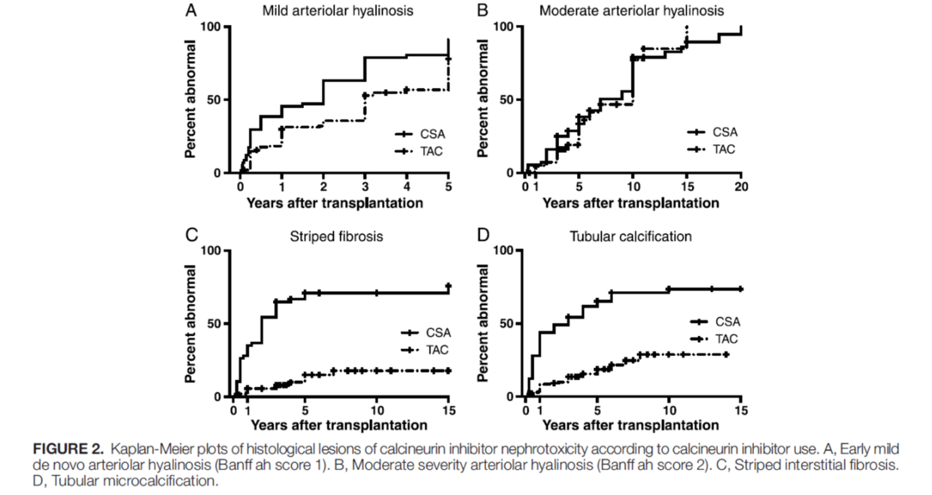
RESULTS
Transplantation ■ August 2016 ■ Volume 100 ■ Number 8

Slide 17
DISCUSSION
This unique, longitudinal cohort study evaluated the histological development of CNI nephrotoxicity in the modern TAC era compared with the older CSA era, and found both similarities and differences.
Transplantation ■ August 2016 ■ Volume 100 ■ Number 8

Slide 18
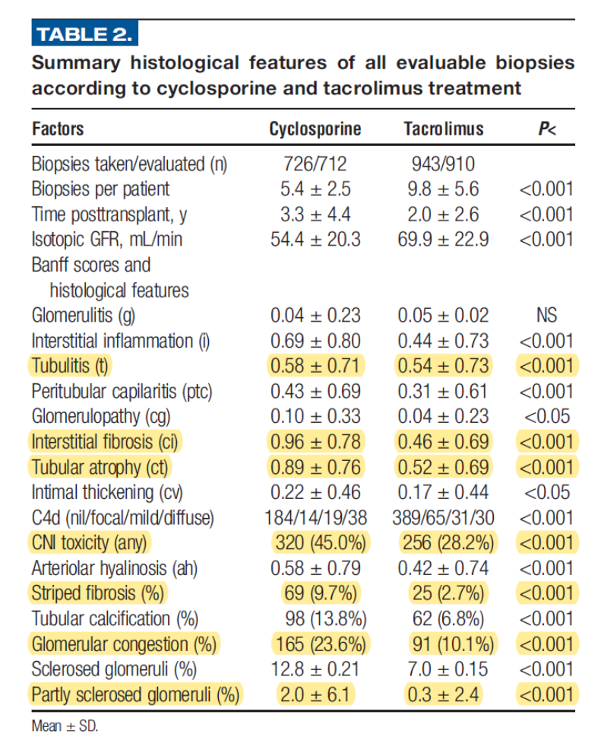
DISCUSSION

Slide 19
DISCUSSION
Although the incidence of acute mild arteriolopathy, striped interstitial fibrosis, glomerular congestion, and tubular microcalcification were all ameliorated in TAC biopsies, the inexorable progression of chronic arteriolar hyalinosis was unchanged from the CSAera.
Transplantation ■ August 2016 ■ Volume 100 ■ Number 8

Slide 20
DISCUSSION
Tacrolimus therapy reduced mild arteriolar hyalinosis, striped fibrosis, and tubular microcalcification, possibly attributable to CSA-mediated microvascular toxicity.
Cyclosporine produces greater vasoconstriction in both animal19 and human studies, compared with TAC.
Cyclosporine activates the renin-angiotensin system, increases secretion of vasoconstrictors including endothelin and thromboxane, while reducing vasodilatory prostacyclin, prostaglandin E2, and nitric oxide synthase.
Transplantation ■ August 2016 ■ Volume 100 ■ Number 8

Slide 21
DISCUSSION
Cyclosporine increased rates of acute nephrotoxicity (HR, 1.49; 95% CI, 1.04-2.14) compared with TAC in a large indication biopsy study.
Transplantation ■ August 2016 ■ Volume 100 ■ Number 8

Slide 22
DISCUSSION
Calcineurin inhibitors are directly cytotoxic to tubular cells at high concentrations.
Tubular atrophy correlated with arteriolar hyalinosis, and interstitial fibrosis was more pronounced with CSA compared with TAC, even when the effects of immune injury were controlled by multivariate analysis.
Transplantation ■ August 2016 ■ Volume 100 ■ Number 8

Slide 23
Conclusion
Our results favor the use of TAC over CSA with less early microvascular nephrotoxicity, comparable chronic toxicity, and less rejection and immune mediated graft damage—producing a wider therapeutic margin.
Transplantation ■ August 2016 ■ Volume 100 ■ Number 8

Slide 24
Copyright © 2020 Wolters Kluwer Health, Inc.

Slide 25
Major drug-specific toxicities

Slide 26
The three major side effects of the drug (nephrotoxicity, neurotoxicity, and diabetogenicity) were comparable to cyclosporine.
Hypertension and hyperlipidemia were less than in historical cyclosporine controls, and the cosmetic effects of cyclosporine (hirsutism, gingival hyperplasia, and facial brutalization) had not been seen.”

Slide 27
Cosmetic Side Effects
The cosmetic benefits of tacrolimus over cyclosporine are well established.

Slide 28
Gingival hyperplasia, which affects many patients treated with cyclosporine, is not seen with tacrolimus and conversion from cyclosporine to tacrolimus has been used to manage this problem.
Cyclosporine causes hirsutism, whereas tacrolimus is associated with alopecia; patient and clinician preferences generally favor dealing with the latter over the former.

Slide 29
Hypertension and hyperlipidemia
Both cyclosporine and tacrolimus are implicated in post-transplant hypertension and hyperlipidemia.
These mechanisms include renal vasoconstriction, increased sodium retention and in the case of cyclosporine but not tacrolimus, an increased sympathetic tone.

Slide 30
Tacrolimus has been shown to activate the renal sodium chloride co-transporter (NCC), and the inhibition of NCC with a thiazide diuretic may be especially effective in treating tacrolimus-induced hypertension.

Slide 31
Most studies indicate more favorable lipid profiles with tacrolimus than cyclosporine.
In hyperlipidemic patients, the relative lack of drug-drug interaction between statins and tacrolimus (versus cyclosporine) eases management

Slide 32
Neurotoxicity
Neurotoxicity, with tendencies to headache, tremor, insomnia, and paresthesia, is common with tacrolimus.
The mechanism of CNI neurotoxicity is uncertain and has been hypothesized to be related to CNI induced disruption of the blood brain barrier, leading to vasogenic edema and apoptosis.

Slide 33
The incidence of CNI neurotoxicity is higher with tacrolimus versus cyclosporine and may improve with a reduction in dose or substitution with cyclosporine or non-CNI immunosuppression.
Switching from immediate release tacrolimus (IR-tac) to once daily LCP-tacrolimus, which has a lower drug peak, decreased tremors.

Slide 34
Diabetogenicity
New-onset diabetes after transplantation (NODAT) is common.
In a tightly-controlled, randomized, prospective clinical trial involving 567 non-diabetic kidney recipients (the DIRECT trial), PTDM or impaired fasting glucose was noted in 33% of tacrolimus-treated patients and also in 26% of those on cyclosporine, (p= 0.046) but with no significant difference in short term clinical outcomes

Slide 35
In practice, minimization or avoidance of corticosteroids has proven efficacious in reducing the frequency or severity of PTDM.
Conversion from twice daily tacrolimus to once daily tacrolimus (ER-tacrolimus) has been studied in stable transplant patients with a possible short term benefit in insulin secretion and better glycemic control, but lowered risk of PTDM has not been seen in larger studies nor in a meta-analysis.

Slide 36
Nephrotoxicity
From its earliest use in humans, cyclosporine was known to be nephrotoxic.
Several studies, along with prevailing clinical impressions, supported tacrolimus as less nephrotoxic than cyclosporine.

Slide 37
In ELITE-SYMPHONY, eGFR remained higher in the tacrolimus-treated patients out to three years post-transplant, a group that also experienced substantially less rejection.

Slide 38
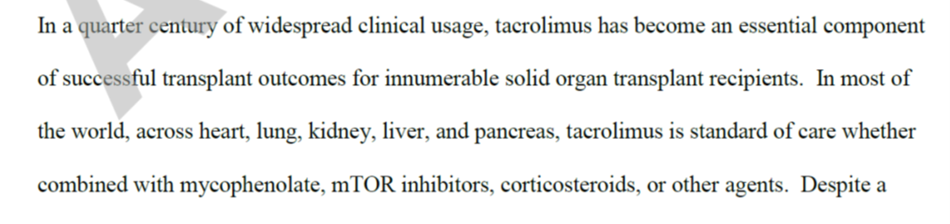

Slide 39

THANK YOU FOR YOUR ATTENSION

